Slide 1
Game AI/Game Engines 2 Obstacle Avoidance
Dr Bryan Duggan
Dublin Institute of Technology

Slide 2
What we will learn
Rays and spheres (pre-requisites)
Obstacle avoidance
How to avoid spherical objects
Flocking
Separation, cohesion, alignment
Combining steering behaviours

Slide 3
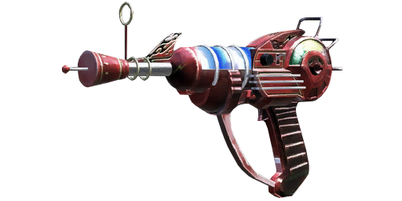
Ray
A line in 3D space that extends outwards from an origin
Can be bounded
Just check distance from the origin
A ray is defined by
Origin
Direction (look)
Mathematically
p(t) = p₀ + tu

Slide 4
Spheres
The equation of a sphere is:
x² + y² + z² ⁼ r²
If p is a point on the sphere, you can write the vector form of a sphere equation:
p.p = r²
If we call the centre point c, then we can write:
(p – c).(p - c) = r²
OR:
(p – c).(p - c) - r² = 0

Slide 5
A Ray/Sphere intersection
3 possibilities
No intersection
1 intersection
2 intersections

Slide 6
Recall:
A ray is:
p(t) = p0 + tu
We want to find the value for t, so we can substitute into the ray equation
So the ray sphere intersection is given by:
(p0 + tu – c).(p0 + tu - c) - r² = 0
OR (just rearrange):
(tu + p0 – c).(tu + p0 - c) - r² = 0
To solve this, we would like to get the equation into the form of a quadratic equation:
At² + Bt + c
If we do, we can use:

Slide 7
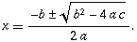
Solution to a quadratic equation:
If the Discriminant is: - 0 there is exactly one root:
- Positive there are 2 real roots
- Negative there are 2 imaginary roots
The Discriminant

Slide 8
So how do we do it??
(tu + p0 – c).(tu + p0 - c) - r² = 0
Dot product is distributive:
a.(b + c) = a.b + a.c
(a + b).(a + c) = aa + ac + ba + bc
So…
(tu + p0 – c).(tu + p0 - c) - r² = 0
Becomes…

Slide 9
(tu + p0 – c).(tu + p0 - c) - r² = 0
tu.tu + tu.(p0 – c) + (p0 – c).tu + (p0 – c).(p0 – c) - r²
Which becomes:
u.ut² + 2u(p0 – pc)t + (p0 – c).(p0 – c) - r²

Slide 10
So:
a = u.u
b = 2u(p0 – pc)
c = (p0 – c).(p0 – c) - r²
Discriminant = b² – 4ac
If (Discriminant < 0)
Return false
Else
Calculate 1 or 2 values for t
Calculate 1 or 2 points by substituting into ray equation:
p(t) = p₀ + tu

Slide 11
Obstacle avoidance
Steers the ship to avoid obstacles lying in its path.
Any obstacle that can be approximated by a circle (2D) or a sphere (3D)
This is achieved by steering the vehicle so as to keep a rectangular area — a detection box, extending forward from the vehicle — free of collisions.
The detection box's width is equal to the bounding diameter of the vehicle, and its length is proportional to the vehicle's current speed — the faster it goes, the longer the detection box.
http://www.red3d.com/cwr/steer/Obstacle.html

Slide 12
The algorithm
Calculate the length of the detection box
minLength + minLength * (speed / max_speed)
Get the game objects tagged “obstacle”
Make a list of all the obstacles within range of the detection box
Check the distance from the boid to the obstacles
We only consider those in range and discard the rest
For each of the obstacles in range
Transform the position of the obstacle by the inverse world transform of the boid
This brings the obstacle into the boid’s local space...
We can then discard all the obstacles with a negative Z (because they are behind the boid)
See diagrams on next page...

Slide 13
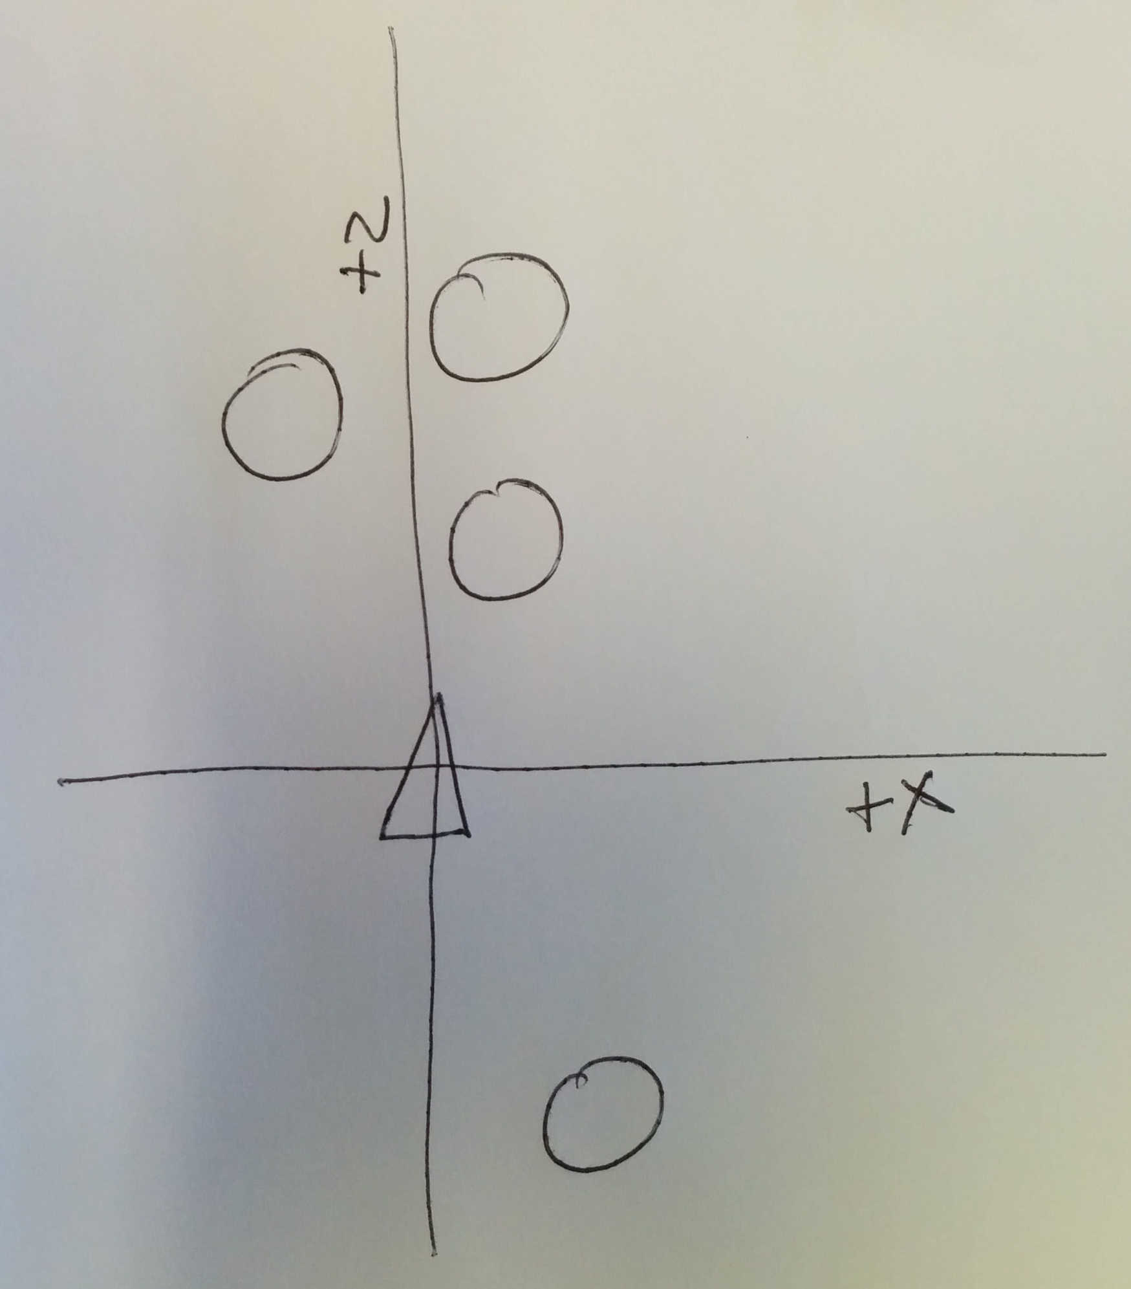
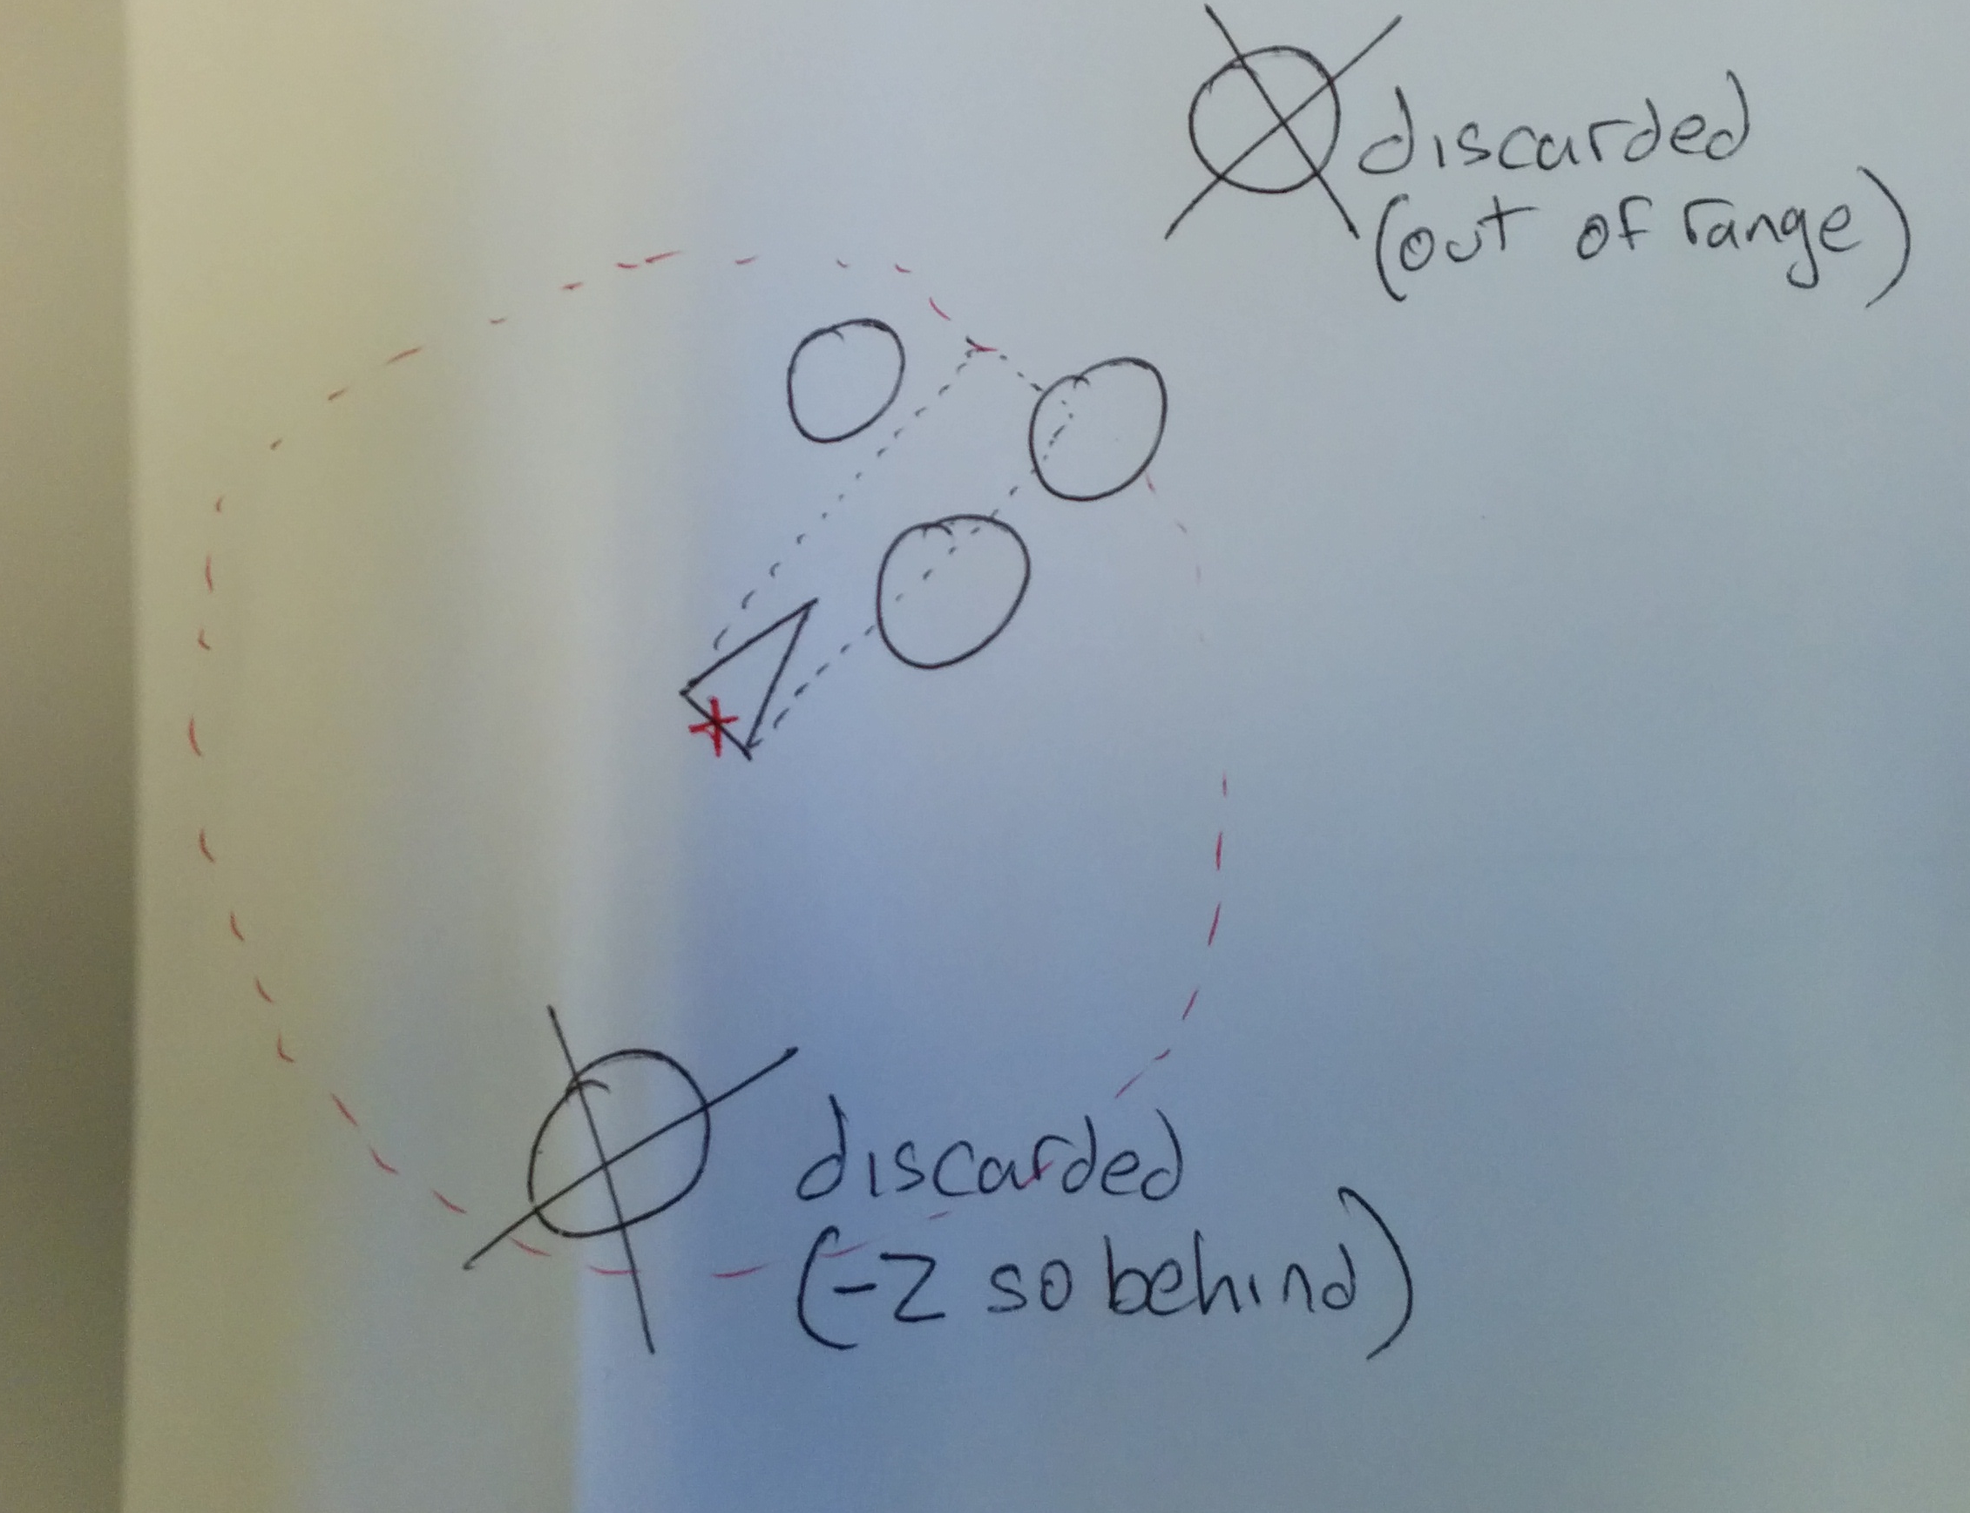
World space
Local space
(* inverse of steerable’s world transform)

Slide 14
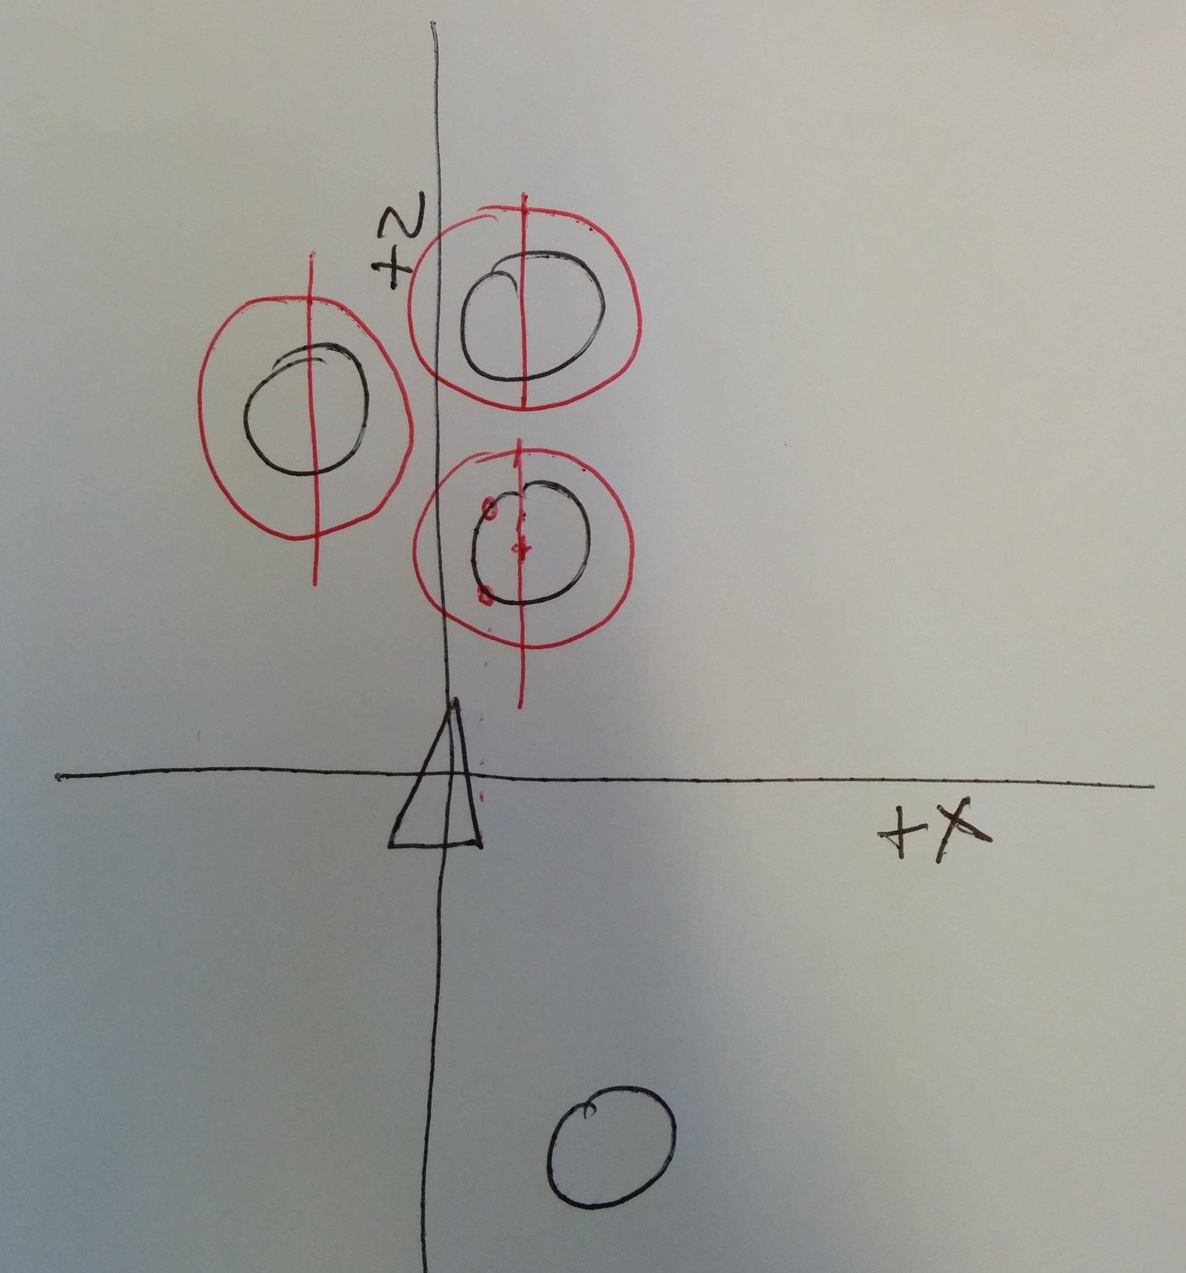
Next we expand the radius of the obstacle by the radius of the boid
We only consider obstacles where the absolute value of X and Y of the position of the obstacle are less than the expanded radius

Slide 15
Next we do a ray sphere intersection test
Make a ray from origin(0,0,0) and direction of (0,0,1)
Remember we are in local space!
Make a sphere from the centre point of the local position of the obstacle and radius of expanded radius
Then we only need to check one ray (the centre line ray) against the sphere
We do this for all the obstacles that satisfy the above conditions and pick only the closest one

Slide 16
If there is an obstacle that satisfies the above, we calculate the 3 forces
Lateral X and Y to steer around left/right and up/down
Braking force on the Z axis
X and Y forces are identical
Subtract the absolute value of obstacle X and Y from expanded radius
Change the sign depending on whether the force should up left/right up/down
Scale by the distance to the obstacle
X force (braking force)
Subtract the absolute value of obstacle Z from expanded radius
Multiply by a scaling factor
Finaly transform back to world space
Make sure to use transformNormal rather than transform position!

Slide 17
Tagging obstacles in range...
// Tag obstacles in range
foreach (GameObject obstacle in obstacles)
{
Vector3 toCentre = transform.position - obstacle.transform.position;
float dist = toCentre.magnitude;
if (dist < boxLength)
{
tagged.Add(obstacle);
}
}
...
...

Slide 18
foreach (GameObject o in tagged)
{
Vector3 localPos = transform.InverseTransformPoint(o.transform.position);
// If the local position has a positive Z value then it must lay
// behind the agent. (in which case it can be ignored)
if (localPos.z >= 0)
{
// If the distance from the x axis to the object's position is less
// than its radius + half the width of the detection box then there
// is a potential intersection.
float obstacleRadius = o.transform.localScale.x / 2;
float expandedRadius = GetRadius() + obstacleRadius;
if ((Math.Abs(localPos.y) < expandedRadius) && (Math.Abs(localPos.x) < expandedRadius))
{
// Now to do a ray/sphere intersection test. The center of the
// Create a temp Entity to hold the sphere in local space
Sphere tempSphere = new Sphere(expandedRadius, localPos);
// Create a ray
BGE.Geom.Ray ray = new BGE.Geom.Ray();
ray.pos = new Vector3(0, 0, 0);
ray.look = Vector3.forward;
// Find the point of intersection
if (tempSphere.closestRayIntersects(ray, Vector3.zero, ref intersection) == false)
{
continue;
}
// Now see if its the closest, there may be other intersecting spheres
float dist = intersection.magnitude;
if (dist < distToClosestIP)
{
dist = distToClosestIP;
closestIntersectingObstacle = o;
localPosOfClosestObstacle = localPos;
}
}
}
}

Slide 19
if (closestIntersectingObstacle != null)
{
// Now calculate the force
float multiplier = 1.0f + (boxLength - localPosOfClosestObstacle.z) / boxLength;
//calculate the lateral force
float obstacleRadius = closestIntersectingObstacle.transform.localScale.x / 2; // closestIntersectingObstacle.GetComponent<Renderer>().bounds.extents.magnitude;
float expandedRadius = GetRadius() + obstacleRadius;
force.x = (expandedRadius - Math.Abs(localPosOfClosestObstacle.x)) * multiplier;
force.y = (expandedRadius - Math.Abs(localPosOfClosestObstacle.y)) * multiplier;
// Generate positive or negative direction so we steer around!
// Not always in the same direction as in Matt Bucklands book
if (localPosOfClosestObstacle.x > 0)
{
force.x = -force.x;
}
// If the obstacle is above, steer down
if (localPosOfClosestObstacle.y > 0)
{
force.y = -force.y;
}
//apply a braking force proportional to the obstacle's distance from
//the vehicle.
const float brakingWeight = 0.01f;
force.z = (expandedRadius -
localPosOfClosestObstacle.z) *
brakingWeight;
//finally, convert the steering vector from local to world space
// Dont include position!
force = transform.TransformDirection(force);
}

